Slide 1
UNIT 1
Introductions

Slide 2
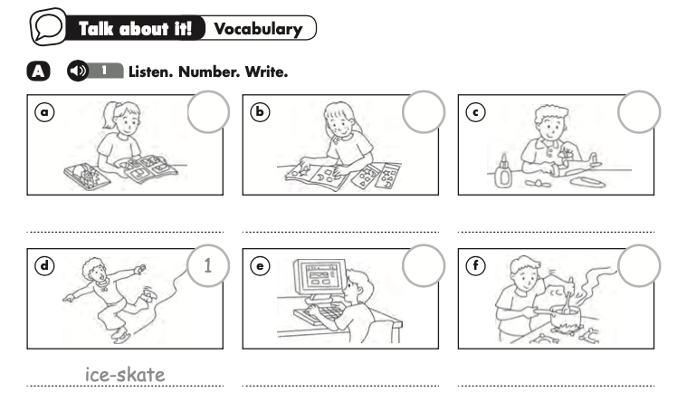
5
3
4
read comic books
collect stickers
build models
2
6
go on the internet
cook

Slide 3
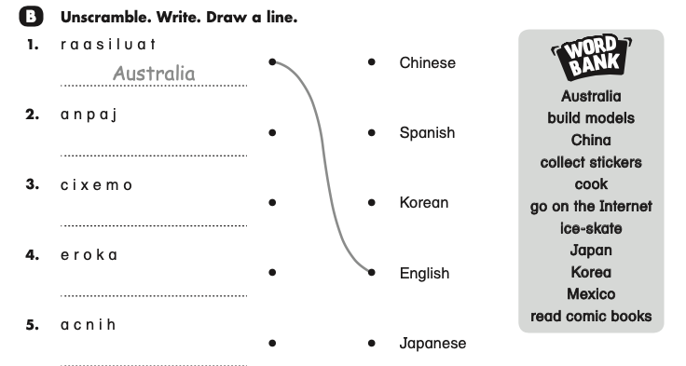
Japan
Mexico
Korea
China

Slide 4
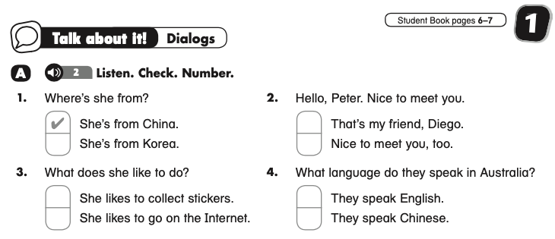
4
2
3

Slide 5
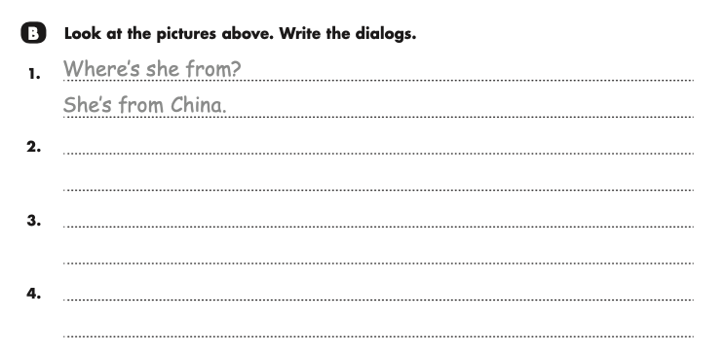
Hello, Peter. Nice to meet you.
Nice to meet you, too
What does she like to do?
She likes to go on the Internet
What language do they speak in Australia?
They speak English.

Slide 6
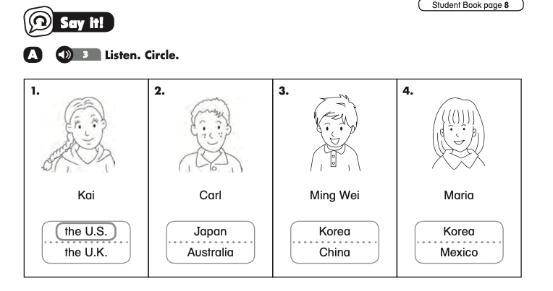

Slide 7
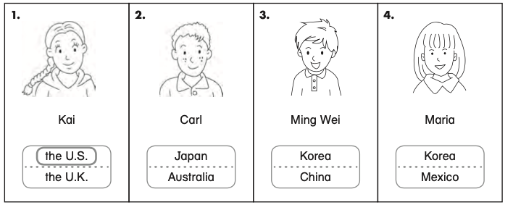
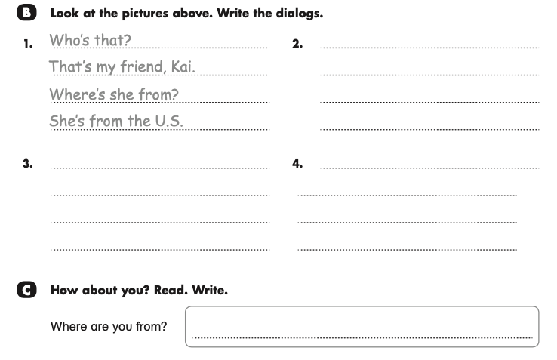
Who’s that?
That’s my friend, Carl.
Where’s he from?
He’s from Australia.
Who’s that?
Who’s that?
That’s my friend, Ming Wei
That’s my friend, Maria
Where’s he from?
Where’s she from?
He’s from China.
She’s from Mexico.

Slide 8
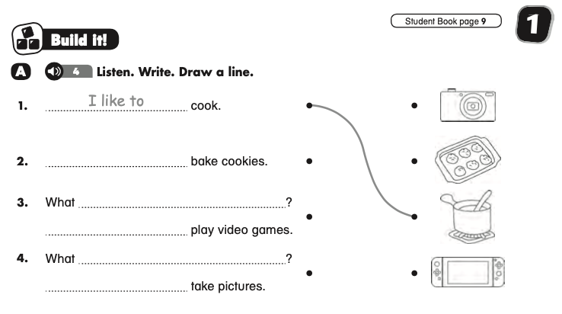
He likes to
does she like to do
She likes to
do you like to do
I like to

Slide 9
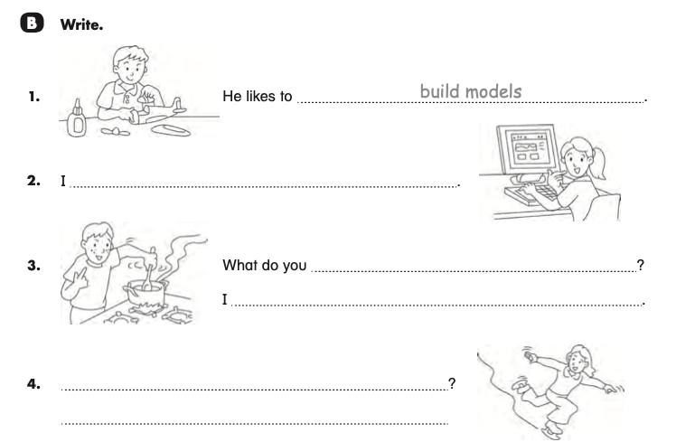
like to go on the Internet
like to do
like to cook
What does she like to do
She likes to ice-skate.

Slide 10
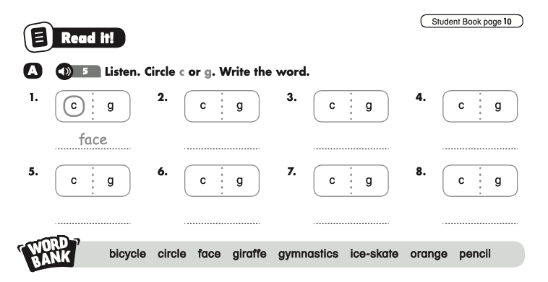
giraffe
bicycle
circle
orange
pencil
ice-skate
gymnastics

Slide 11
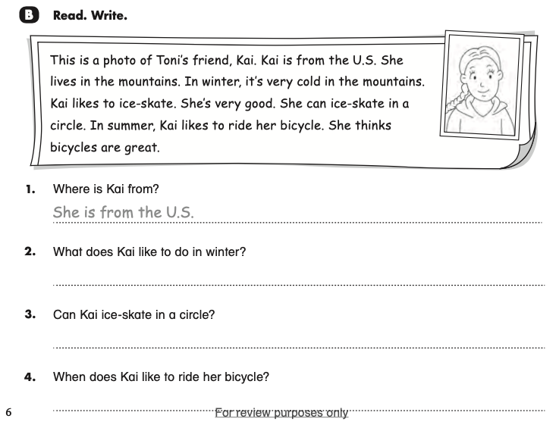
She likes to ice-skate in winter.
Yes, she can.
She likes to ride her bicycle in summer.

Slide 12
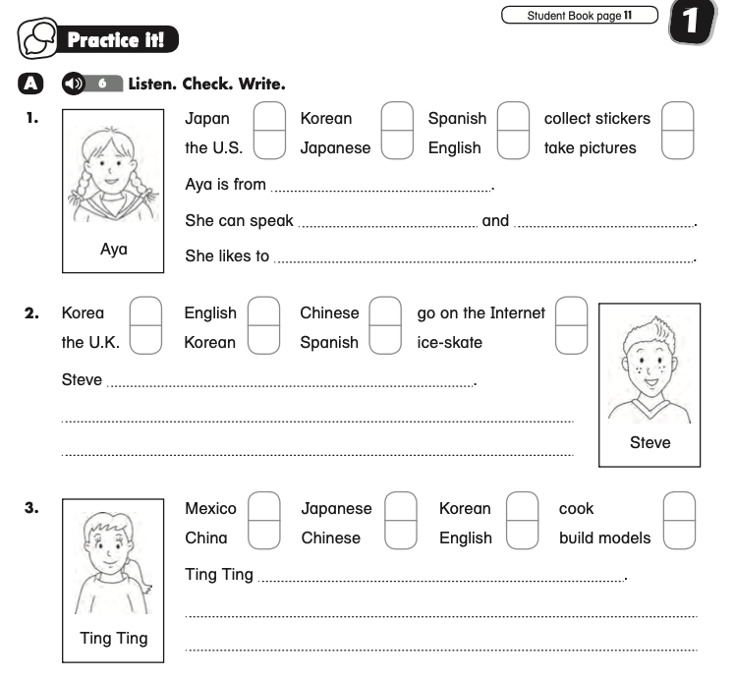
Japan
Japanese
English
take pictures
is from the U.K.
He can speak English and Spanish.
He likes to go on the Internet.
is from China
She can speak Chinese and English.
She likes to cook.

